Slide 1
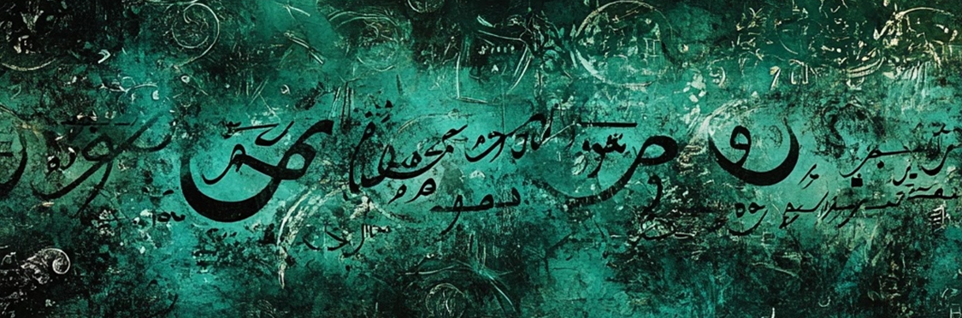
AI-Enabled Narrative Analytics for Persian and Kurdish
Karine Megerdoomian (Zoorna Institute) & Emmanuel Garcia (Florida International Univ.)
May 2025
North American Conference on Iranian Linguistics 4
University of Toronto Mississauga
Notes:
Why Narratives?
Narratives are foundational to human expression across cultures
Folktales, news, memoirs, podcasts, visual media

Slide 2
What is a Narrative?
‘Narrative is a recounting of things that have happened, involving a sequence of events meaningfully connected in a temporal and often causal relation, typically structured with a beginning, middle, and end’ (Labov and Waletzky 1967; Labov 2011; Onega & Landa 2014)
‘recounting of things spatiotemporarily distant’(Toolan 2001)
Narrative Analysis in linguistics:
  The structural or componential analysis of narratives identifies the different elements that constitute a narrative and how these elements interact and change (Hogan 2006)
  The functional analysis of narratives examines the purpose(s) of narrative (Schiffrin 1996)
Notes:
A narrative is a structured recounting of events, involving one or more actors, situated in time and often causally or temporally linked, that is told for a communicative or interpretive purpose.

Slide 3
Narrative Analytics in NLP
Structured Representation
(Liu and Luo 2024)
Event description –what
Participants –who
Location –where
Temporal information –when
Cause –why
Manner –how
The computational study and modeling of narratives—the structured accounts of events (and subevents) involving characters, actions, and temporal sequences.
Applications across various domains: summarization, intelligent question answering, knowledge discovery systems, education tools, geopolitical events summary and therapeutic and mental health uses.
Notes:
Natural Language Processing (NLP) enables automatic analysis of narratives

Slide 4
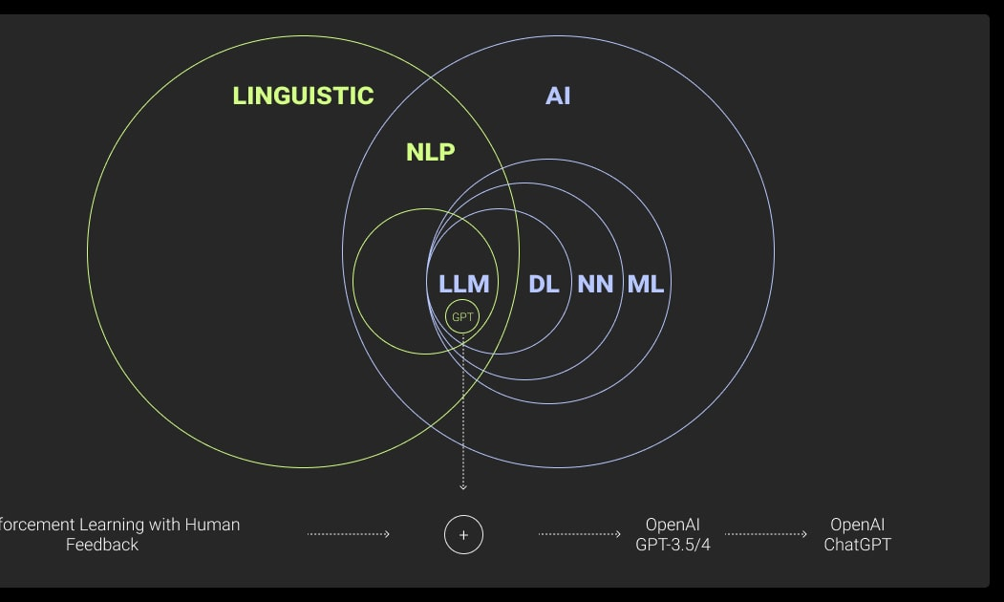
Leveraging Large Language Models (LLMs)
Traditional NLP
Build a pipeline of components for tokenization, entity detection, part of speech tagging, parsing, event detection, semantic analysis, temporal reasoning, etc. (for each new language)
LLM approach
Perform multi-step reasoning with minimal or no task-specific pipelines. Holistic, multilingual, generalized analysis out-of-the-box. Tuning for task-specific results.

Slide 5
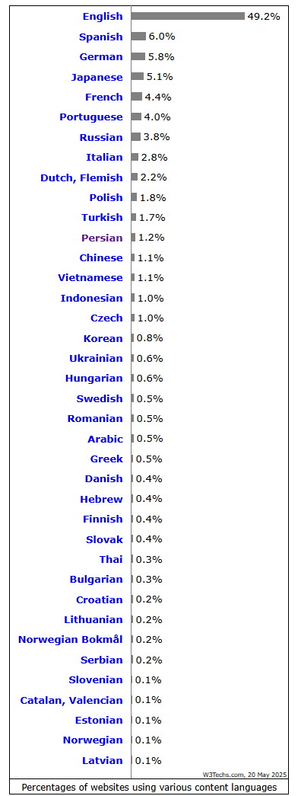
AI and Low-Resource Languages
Large Language Models (LLMs) do not perform as well on Low-Resource Languages (LRLs)
Lack of available data for LLMs to train on
Absence of fine-tuned instruction datasets (with paired input and expected output)
Need to tune LLM additionally
Change the AI ecosystem by ensuring LRL models are accurate, reflect local customs and norms, and are useful to the communities that will be using them
Notes:
graph shows a distribution of data across the internet divided into language groups (https://toloka.ai/blog/low-resource-languages/)
Why Integrating Low Resource Languages Into LLMs Is Essential for Responsible AI. Toloka Team. May 21, 2024.
approximately 92.65% of GPT-3’s training tokens are in English, leaving a mere 7.35% for all other languages (OpenAI 2023)

Slide 6




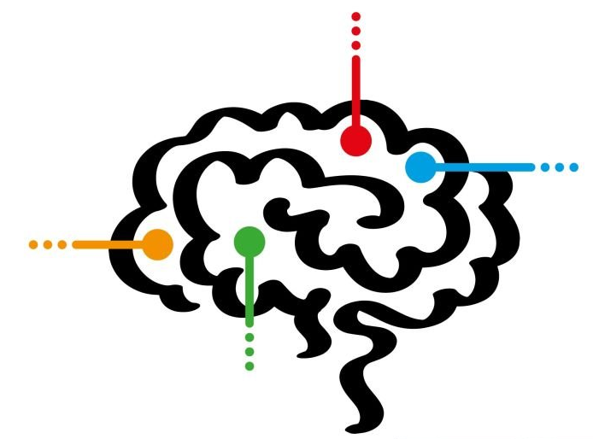




System Overview
ChatGPT
LLaMa
Deepseek
Event & entity detection
Argument
structure
Prompt
Output
Temporal inference & timeline generation
Event & entity
relations
Input Text
Summarization &
translation
Tune Model
Evaluate Results
Annotated Test Files

Slide 7
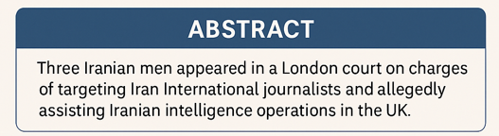

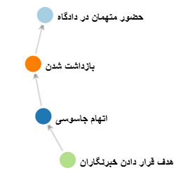
Sample Analysis (Persian) ChatGPT
Persons
Mostafa Sepehvand – 39-year-old defendant
Farhad Javadi-Manesh – 44-year-old defendant
Shapour Qaleh-Ali Khani Nouri – 55-year-old defendant
Organizations & Institutions
Iran International – media network (assumption: target of espionage)
British judicial authorities – UK legal body
British police – law enforcement body
Iranian intelligence organization – unnamed foreign intelligence service
Westminster Court – court venue in London
Locations
Britain – country of legal proceedings and migration
London – city of court appearance
منش۲۷ اردیبهشت ۱۴۰۴ - ۱۷ مه ۲۰۲۵
‌سه مرد ایرانی که به ظن دست داشتن در اقدامات جاسوسی در بریتانیا در دادگاهی در لندن حضور یافتند، متهم شده‌اند که روزنامه‌نگاران شبکه ایران اینترنشنال را هدف قرار داده‌اند.
به گفته مقام‌های قضایی بریتانیا، اقدام این افراد معادل ارتکاب «خشونت جدی» است.
مصطفی سپهوند ۳۹ ساله، فرهاد جوادی‌منش ۴۴ ساله و شاپور قلعه‌علی خانی نوری ۵۵ ساله امروز ۲۷ اردیبهشت، ۱۷ مه، در دادگاه وست‌مینیستر لندن حضور یافتند.
هر سه متهم بعد از درخواست پناهندگی، موفق به دریافت اجازه اقامت موقت در بریتانیا شده‌اند. آنها بین سال‌های ۲۰۱۶ تا ۲۰۲۲ میلادی با استفاده از قایق‌های کوچک و مخفی شدن در کامیون خودشان را به بریتانیا رسانده‌اند. آقای سپهوند در سال ۲۰۱۶ در حالی که در یک کامیون پنهان شده بود، وارد بریتانیا شده است.
پلیس بریتانیا ساعات اولیه صبح امروز اعلام کرده بود این سه نفر که شنبه دو هفته پیش بازداشت شده بودند به ظن ارتکاب رفتاری که احتمالاً به یک «سازمان اطلاعاتی ایران» کمک می‌کند، متهم شده‌اند.
Key takeaways
Espionage charges in the UK
Transnational repression and threats to free press
Misuse of asylum pathways
Ongoing judicial process
National security implications
enables
causes
causes
2016
2022
2025-05-03
2025-05-17
Timeline
Sepahvand entered UK hidden in a truck
Three men arrived in UK via small boats and hiding in trucks
Arrest of the tree men
Police announcement regarding charges
Court appearance at Westminster
Notes:
https://www.bbc.com/persian/articles/c20qlq42e4vo

Slide 8
Sample Analysis (Sorani) ChatGPT
لە شەوی ١٥ی ئەیلوولی ٢٠٢٣دا، تەقینەوەیەک لە نێو بازاڕی سلێمانی ڕوویدا.ڕەزام حەمە، کەسێکی فرۆشیار، لە کاتی تەقینەوەکە بریندار بوو.هاوڵاتیان بەخێرایی کەسی بریندارەکان گەیاندن بۆ نەخۆشخانە.ڕۆژی دوای ئەو ڕووداوە، حکومەت ڕاگەیاند کە تاقیکردنەوە دەستپێدەکات.تاکو ئێستا، هێشتا کەسێک بەتاوانبار نەناسراوە.
ID | Description | Type | Explict/Implicit
E1 | Bombing in Sulaimani bazaar | Violent act | Explicit
E2 | Rezam Hama injured | Casualty | Explicit
E3 | Civilians transported wounded to hospital | Humanitarian response | Explicit
E4 | Government announces investigation | Administrative response | Explicit
E5 | Perpetrator not yet identified | Legal/Forensic | Explicit
E6 | Public panic & fear | Social effect | Implicit
E7 | Delay in justice process | Government failure | Implicit
On the night of September 15, 2023, an explosion occurred in the Sulaimani bazaar.
Rezam Hama, a vendor, was injured during the explosion.
Civilians quickly transported the injured to the hospital.
The day after the incident, the government announced that an investigation would begin.
As of now, no one has been identified as responsible.
Causal & Narrative Inference
Bombing → Casualties → Community response (E1 → E2 → E3)
Bombing → Government pressure → Investigation (E1 → E4)
Lack of arrest → Public uncertainty/fear (E5 → E6/E7)
Sept 15 (night)
Sept 16
Ongoing
Bombing
→ Victims injured and taken to hospital
Government statement
No one arrested

Slide 9
System Overview
Event & entity detection
Argument
structure
Prompt
Output
Temporal inference & timeline generation
Event & entity
relations
Input Text
Summarization &
translation
Tune Model
Evaluate Results
Annotated Test Files

Slide 10
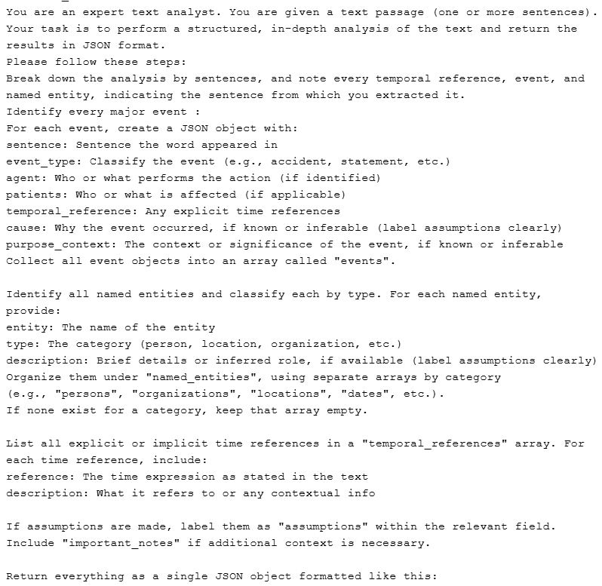
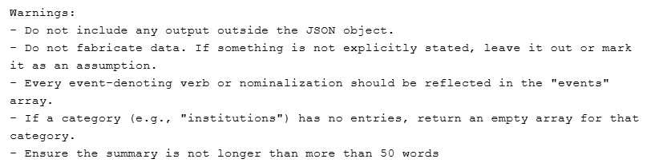
Prompting Techniques
In-Context Learning (ICL)
Language model learns to perform the task by conditioning on a small number of instructions provided in the input prompt.
Definition-driven ICL
Task description is structured and provides specific output format.
Prompt Chain
Each prompt feeds into the next with structured outputs to avoid error propagation down the analytic pipeline.
Example:
1. Entity and event detection
➔ 2. Entity and event relations

Slide 11
Prompts for Tuning
Few-shot Prompting: Provide 2-5 examples in the prompt for the specific challenging task to improve.
Chain-of-Thought (CoT) reasoning: Encourage the LLM to generate intermediate reasoning steps before arriving at the final answer, improving performance on complex tasks that require multi-step logic or inference.
Causal Inference: Identify any causal relationships among the events. Where applicable, explain the inferred causality using contextual or narrative logic.
Implicit Reasoning: If any events or relations are implied rather than stated, infer them using commonsense or discourse-level reasoning.
Expected Output Format:
Event A → [BEFORE / AFTER / CAUSES / CAUSED BY / SIMULTANEOUS WITH] → Event B
Justification (optional): [brief explanation]
Sample CoT prompt
Notes:
LLMs often perform better when they "think out loud." CoT mimics human reasoning by breaking down a problem into sub-steps.
Chain-of-Thought prompting is a method where you prompt an LLM not just to give an answer, but to "think out loud"—writing out the intermediate steps or reasoning before the final output.
In the case of cause-effect inference, this means the model explains why something happened or what it will lead to, step by step.
You can use CoT to reason in both directions:
Forward: "Event A → leads to → Event B"
Backward: "Event B happened → what could have caused it?"
Example (Backward):
"The streets were empty, and shops were closed."
No retraining required — great for low-resource languages or rapidly changing domains.Enables rapid prototyping of NLP systems.Forms the basis for prompt engineering and chain-of-thought reasoning.

Slide 12
Temporal Reasoning
Document Date: Oct 12, 2016
Sentence | Event | Temporal Expression | Resolution
زهرا در فروردین ۱۳۸۵ تحصیل در دانشگاه تهران را آغاز کرد. | Began studies at Tehran University | Farvardin 1385 | April 2006
او چهار سال بعد در خرداد ۱۳۸۹ فارغ‌التحصیل شد. | Graduated | Four years later, Khordad 1389 | June 2010
در طول تحصیل، زهرا هر سه‌شنبه به کلاس موسیقی می‌رفت. | Attended music class | During (studies), every tuesday | 2006-2010
در تابستان ۱۳۹۰ به اصفهان سفر کرد. | Traveled to Isfahan | Summer 1390 | Summer 2011
سه روز پیش، او دوباره به تهران بازگشت. | Returned to Tehran | Three days ago | Inferred: 9 Oct 2016
او به مدت شش ماه در یک شرکت فناوری کارآموزی کرد. | Interned at a tech company | Six months | Inferred: March-Sept 2013
از مهر ۱۳۹۲ تا شهریور ۱۳۹۵ به طور رسمی در همان شرکت استخدام شد. | Was employed at that company | From Mehr 1392 to Shahrivar 1395 | Oct 2013 – Sept 2016
در حالی که در آن شرکت مشغول به کار بود، دوره‌های آموزشی متعددی گذراند. | Attended training courses | While | Oct 2013 – Sept 2016
پس از اتمام آن دوره، او تصمیم گرفت برای ادامه تحصیل به اروپا برود. | Decided to continue studies in Europe | After finishing (that internship) | Vague: Post-Sept 2016
Temporal Categories
Date
Range
Duration
Periodic
Relative Date
Event Relation
Music classes
Travel
Employment
Decision to leave
Education
start
Graduation
Internship
Return to Tehran

Slide 13
Evaluation (Persian)
Matched output of each LLM against a
pre-annotated test set containing the expected output.
Accuracy
Evaluation set = 20 documents, 160 sentences, ~2,500 words.
Notes:
Evaluation set curated for the specific challenges we want to test (with help of LLM)

Slide 14
Evaluating Linguistic & NLP Challenges
Issue | Example Test Type
Event detection granularity | Can the system distinguish core from peripheral events? Does it identify implicit events?
Light verb construction parsing | Are LVCs unified and semantically labeled correctly?
Role labeling | Does it identify agents/patients, even if implicit?
Temporal inference | Can it resolve vague expressions and normalize time?
Event-event relations | Can it detect causality, contrast, and sequencing?
Aspect/modality interpretation | Does it distinguish telic vs. atelic readings?
Narrative structure segmentation | Can it identify orientation, complication, resolution?
Co-reference | Can it track entities/events across clauses/documents?
Cross-lingual bias | Does it hallucinate or flatten culturally specific terms?
Notes:
WE BUILD TESTFILES WHICH TEST FOR THESE THINGS

Slide 15
Events
Light Verb Constructions
System correctly identifies both regular LVCs and separable LVCs | تگرگ لطمه شدیدی به باغ من زد. The hail caused severe damage to my garden. (The hail severely damaged my garden.)
Correctly identified
Serial Verbs: multiple verbs forming a single event chain
System identified 3 related events of movement (go), acquisition (get), and movement (bring) | رفتم گرفتمش آوردمش خونه I went, got him/her/it, brought him/her/it home.
System identified 3 consecutive events of arrival, picking up and delivering. | که‌چکه‌که‌ هات بگرێ، دوای بگوازێ بۆ باوکی
Analyzed as distinct events (inconsistent in Sorani)
Notes:
Treats coordinated events as one also (esp. if purpose-driven)

Slide 16
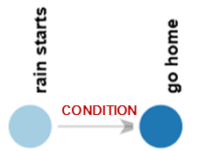
Events (cont.)
Nested Events: relative clauses, nominalization
Expected: reporting attack (on embassy) involvement (in attack) arrest | مقامات اعلام کردند که فردی که در حمله به سفارت دست داشته، دستگیر شده است Authorities announced that the individual who was involved in the embassy attack has been apprehended
Often correctly identified; needs instruction
Conditional Events
Event occurs in undetermined future based on conditional time expression اگه بارون شروع بشه when the rain starts. | اگه بارون شروع بشه میریم خونه. If the rain starts we go home.
Correctly identified
Counterfactuals
E3 (they weren’t there/ had left) → E1 (he went) → [E2 intended to help] E2 not realized. | رفته بود کمکشون کنه ولی نبودند He had gone to help them, but they weren’t there.
Inconsistent output

Slide 17
Implicit information
Implicit arguments: passives, subjectless constructions
Often correctly inferred from context
Sentence | Event Type | Agent | Patient
پنج روز پس از پذیرش، داروی ضدویروس برای بیمار تجویز شد Five days after admission, the antiviral medication was prescribed for the patient. | medical_treatment | doctor | patient
سخنرانی وزیر فرهنگ در روز دوم نمایشگاه برنامه‌ریزی شده است. | speech | Minister of Culture | exhibition attendees
The Minister of Culture's speech has been scheduled for the second day of the exhibition. | planning | exhibition organizers | Minister’s speech
ابتدا، دستگاه را روشن کرده و اجازه دهید تا پنج دقیقه گرم شود First, turn on the device and allow it to warm up for five minutes. |  | user | the device
Coreference (of entities)
مریم وقتی با نرگس صحبت کرد، گفت که خواهرش مریض است و باید او را به بیمارستان ببرد When Maryam spoke with Narges, she said that her sister was sick and that she had to take her to the hospital.
Correctly identified but confused in complex cases

Slide 18
Cultural & Historical Knowledge or Bias
System incorporates historical or cultural knowledge in analysis
Sentence | Event Type | Agent | Patient
در دهه ۱۳۴۰، اصلاحات ارضی آغاز شد که ساختار اجتماعی کشور را تغییر داد. In the 1960s, land reforms began that changed the social structure of the country. | reform_initiation | The Pahlavi government | farmers and large landowners
Notes:
Treats coordinated events as one also (esp. if purpose-driven)

Slide 19
Previous Work
Use Cases
Yaghoobzadeh et al (2012). ISO-TimeML event extraction in Persian text. COLING.
Developed a rule-based and learning-based event extraction system for Persian following the ISO-TimeML schema.
Event Detection F1: 83.1% (learning-based) vs. 75.6% (rule-based)
Class Detection Accuracy: 74.9%Difficulties with adjectives and nominal event recall. High reliance on resource coverage (WordNet/sense lists)
Eshaghzadeh et al (2013). Temporal relation classification in Persian and English contexts. RANLP.
Build a Persian Temporal Relation Classifier (PTRC) for event-event temporal links (e.g., BEFORE, AFTER, SIMULTANEOUS).
Achieved 65.6% accuracy

Slide 20
Comparison to LLM-Based Approach
LLM Advantages
Easily adapted to other languages and new domains.
Better at event inference, implicit information, discontinuous LVCs
More robust for cross-sentence and cross-document analysis
No dependency on structured resources (e.g., FarsNet, PersianWordNet, Dadegan Treebank)
LLM Gaps
Current approach does not map output to a standard schema (e.g., TimeML)
Improve evaluation metrics to obtain Precision/Recall (token/span-level) for direct comparison of results
Extract linguistic features (e.g., tense, aspect) that can be fed into event prompts for improved results

Slide 21
Summary
LLMs enable holistic narrative analysis, capturing causality, temporality, and implicit elements—especially valuable for under-resourced languages like Persian and Kurdish.
Traditional NLP offers precision and schema alignment but struggles with flexibility, implicit reasoning, and multilingual generalization.
LLMs perform surprisingly well out-of-the-box for Sorani and Persian, but results are inconsistent (esp. for Kurdish) and lack explainability.
Key Insights
Combine LLM strengths (inference, multilingualism, context) with traditional NLP precision (structured extraction, schema mapping).
Apply LLMs for causal inference, temporal ordering, and character motivation analysis.
Hybrid Approach
Build annotated datasets for Sorani Kurdish and evaluate systematically.
Explore schema-constrained prompting to bridge LLM outputs with formal evaluation frameworks (e.g., TimeML).
Pilot a modular narrative analytics pipeline integrating LLM + rule-based modules.
Next Steps

Slide 22
Thank you
مرسی
سوپاس
Karine Megerdoomian
karine@zoornainstitute.org
www.karinemegerdoomian.org
www.zoornainstitute.org

